Slide 1



AI Engineering
DEPLOYMENT ENVIRONMENTS

Slide 2

VIRTUAL ENVIRONMENTS

Slide 3

Virtual Environments (venv)
MyComputer
Pandas
numpy
Matplotlib
…
Requests
Tensorflow
Mlflow
Sckit-learn

Slide 4
Virtual Environments (venv)
MyComputer
Pandas=2.22.09
numpy
matplotlib
requests
BeatufiulSoup
Pandas=1.0.19
tensorflow

Slide 5
Virtual Environments (venv)
MyComputer
Pandas=2.22.09
numpy
matplotlib
requests
BeatufiulSoup
Pandas=1.0.19
tensorflow

Slide 6
Virtual Environments (venv)
Computer1
Pandas v2
Numpy v24
Matplotlib v3
Requests v7
Pandas v14
Numpy v5
Matplotlib v9
Requests v1
Computer 2
Pandas v2
Numpy v24
Matplotlib v3
Requests v7
Pandas v14
Numpy v5
Matplotlib v9
Requests v1

Slide 7
EXERCISE
02. Virtual Envs.ipynb

Slide 8
Virtual Environments (venv)

Slide 9
Virtual Environments (venv)
PROD
Pandas
numpy
matplotlib
requests
DEV
Pandas
numpy
matplotlib
requests

Slide 10
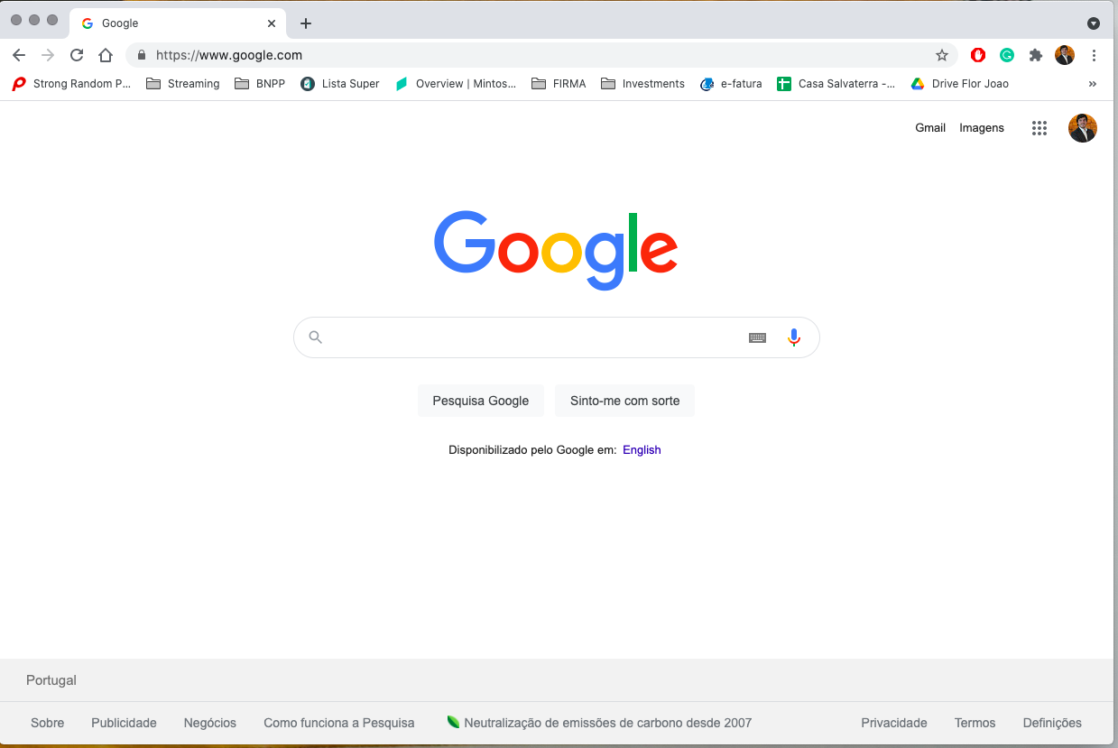
AM I SEEING DIRECTLY WHAT THE DEVELOPERS ARE DOING?

Slide 11


DEV vs PROD
Welcome

Slide 12
DEV vs PROD
Welcome

Slide 13

DEV vs PROD
Welcome

Slide 14
DEV vs PROD
Welcome

Slide 15

DEV vs PROD
Welcome

Slide 16
DEV vs PROD
Welcome

Slide 17
WHAT ABOUT DEPLOYING THINGS FROM ONE ENVIRONMENT TO THE OTHER?

Slide 18
DEV vs PROD
PROD
DEV
Welcome

Slide 19
DEV vs PROD
PROD
DEV
Welcome

Slide 20

DEV vs PROD - Gatekeeping
PROD
DEV
Welcome

Slide 21
BUT HOW DO WE “GIVE” WHAT WE JUST DID TO THESE PEOPLE?

Slide 22
BUT HOW DO WE “GIVE” WHAT WE JUST DID TO THESE PEOPLE?
THERE ARE ACTUALLY A FEW AWAYS

Slide 23
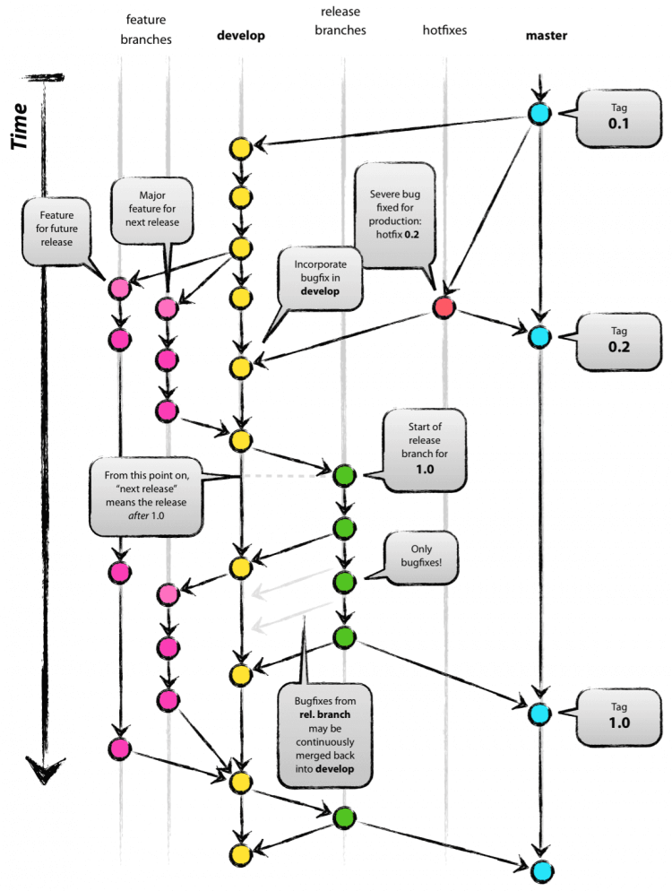
Role of GIT

Slide 24
Role of GIT
Welcome

Slide 25
Role of GIT
Welcome

Slide 26
Role of GIT
PROD
git commit
git push
git merge
DEV
Welcome

Slide 27
Role of GIT
PROD
Hey, it is ready to go
git commit
git push
git merge
DEV
Welcome

Slide 28
Role of GIT
PROD
git pull
git commit
git push
git merge
DEV
Welcome

Slide 29
HOW ABOUT MACHINE LEARNING MODELS?

Slide 30
HOW ABOUT MACHINE LEARNING MODELS?
We can use pickle files!

Slide 31
Role of GIT
PROD
Pickle file
(saved trained model)
git pull
git commit
git push
git merge
DEV
Pickle file
(saved trained model)
Welcome

Slide 32
BUT... I JUST NEED TO TELL A PERSON:
“PUT THIS IN PROD”... AND HE/SHE DOES IT?
WHAT’S THE POINT THEN?

Slide 33
Role of GIT
PROD
git commit
git push
git merge
DEV

Slide 34
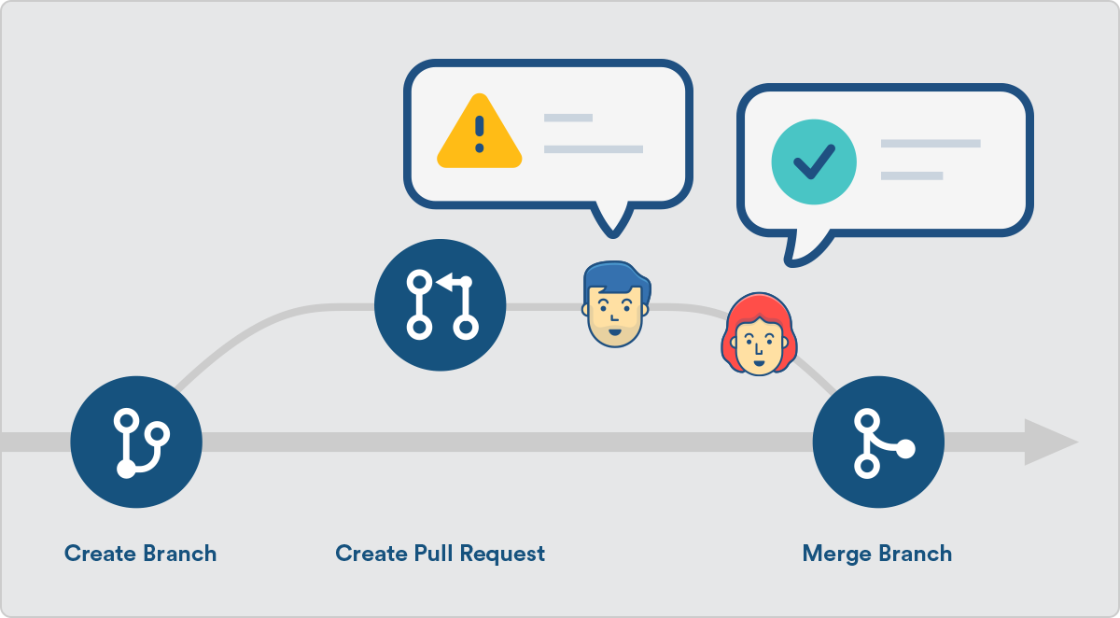
Role of GIT
PROD
CODE REVIEW:
PULL REQUEST
git commit
git push
git merge
DEV

Slide 35
Lets Review
PROD
More than one environment
DEVs cant put things in PROD
Before going to PROD, we need to make a code review
DEV

Slide 36
HAVING THIS IS REALLY GOOD!

Slide 37
HAVING THIS IS REALLY GOOD...
... HOWEVER, QUITE A FEW MANUAL STEPS: CAN WE MAKE IT BETTER?

Slide 38
CI CD

Slide 39
CI CD
SIGN OFF GIVEN THE RESULTS OF THE TESTS

Slide 40
Topics to look out for
Daily data
Daily data
Daily data
Daily data
PROD
Production Maintenance
DEV
Welcome

Slide 41
Topics to look out for
Production Maintenance
Complicated bureaucracy to deploy to production
Welcome

Slide 42
Topics to look out for
I created another env to test everything but I only work on Wednesdays
I have the mindset of 80 year old so I don’t give accesses to anyone
Production Maintenance
Complicated bureaucracy to deploy to production
We validate all changs that go into PRD
I am a senior in the team. Before pushing show me the code
Welcome

Slide 43
Topics to look out for
PROD
Production Maintenance
Complicated bureaucracy to deploy to production
Different infrastructure setup
pandas v0.25.12
(no numpy)
DEV
pandas v2.04.15
numpy v1.0.4

Slide 44
IS THERE REALLY NO WAY TO SOLVE
THIS LAST ONE?

Slide 45
Topics to look out for
PROD
Production Maintenance
Complicated bureaucracy to deploy to production
Different infrastructure setup
pandas v0.25.12
(no numpy)
DEV
pandas v2.04.15
numpy v1.0.4

Slide 46
Virtual Environments (venv)
PROD
Pandas v2
Numpy v24
Matplotlib v3
Requests v7
Pandas v14
Numpy v5
Matplotlib v9
Requests v1
Pandas v2
Numpy v24
Matplotlib v3
Requests v7
Pandas v14
Numpy v5
Matplotlib v9
Requests v1
DEV

Slide 47
”What about everything else besides Python packages:
SQL DB Setups, Drivers intalled in Windows, etc?”

Slide 48


Slide 49
Thank you

